Slide 1


Virtual Connect​
An attempt to help people with speech disabilities​

Slide 2

Team​ Details
: Virtual Connect​
NAME :K.Naga Nitin
CLASS :CSE
SECTION :A
ROLL NO :21075A0503
NAME :T.Harshitha
CLASS :CSE
SECTION :A
ROLL NO :21071A0558
NAME :P.Tanvi
CLASS :ECE
SECTION :D
ROLL NO :21071A04R2

Slide 3

DOMAIN:
02
Cross-Domain Applications (Integrating Computer Applications with other Engineering Disciplines ).

Slide 4

PROBLEM STATEMENT:
Autistic and dumb individuals often encounter challenges in communication and interaction due to difficulties that can hinder effective interpersonal connections.​

Slide 5
IDEA/SOLUTION:
A software which converts user’s gestures into speech .
Comparison with default data
(Image recognition and Gesture analysis)
Adding to the dataset and Enabling the result into microphone
Stop gesture
Finally speech is ready
Image detection
BAILEY DUPONT
Head Office
Next gesture

Slide 6
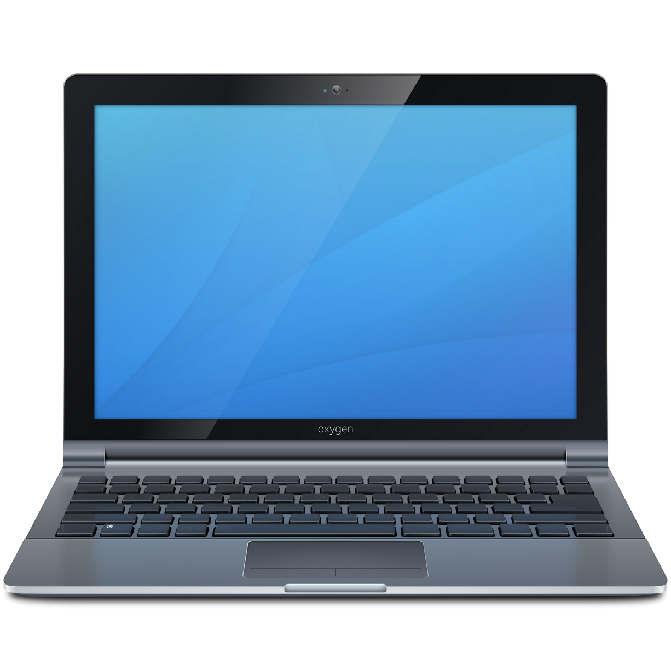
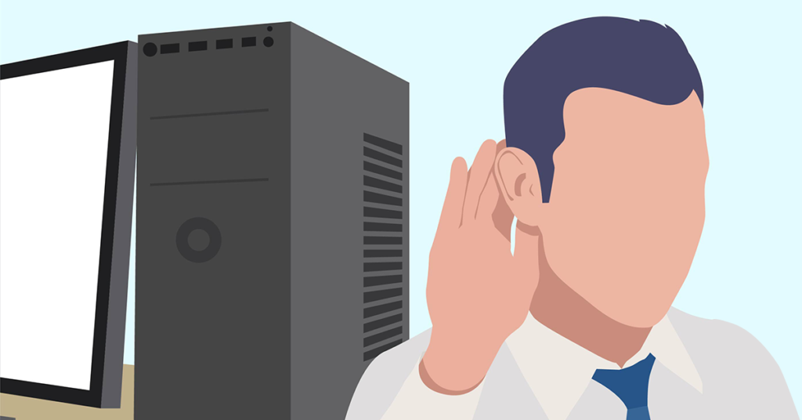
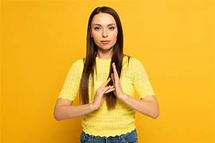
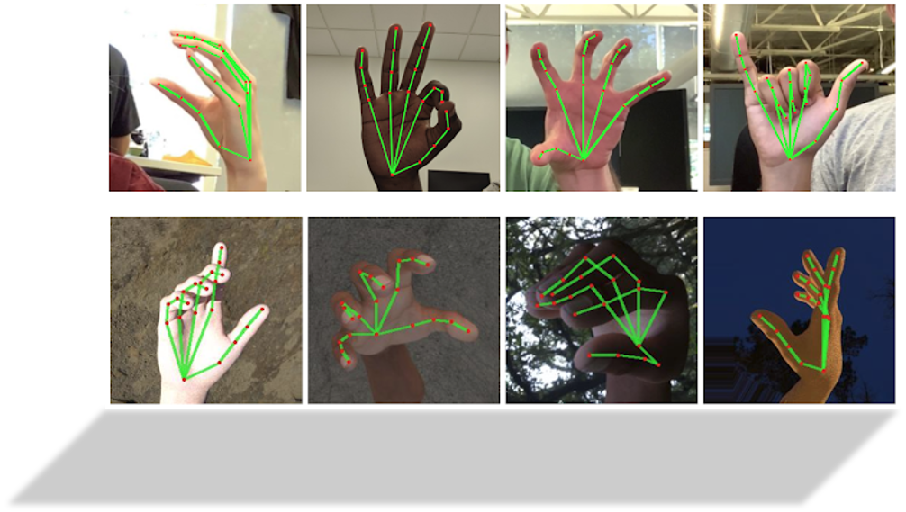
OBJECTIVE:
Developing a software which incorporates gestures and text-based communication to help people with autism communicate about their needs and express their thoughts with family and friends and so that they can live independently.

Slide 7
FUTURE SCOPE:
We can integrate it with mobile app which makes it portable
We can add as an extension in virtual meeting platforms like Google meet , Zoom.
We can also customize based on user’s need

Slide 8
RESOURCES USED:
https://ieeexplore.ieee.org/abstract/document/8081366
Technologies used:​
OpenCv,mediapipe.​

Slide 9
Thank you!

